Slide 1
Variational Autoencoders for Deforming 3D Mesh Models Tan, Qingyang, et al. "Variational Autoencoders for Deforming 3D Mesh Models." arXiv preprint arXiv:1709.04307 (2017).

Slide 2
Introduction
This paper proposes a novel framework called mesh variational autoencoders(mesh VAE), which leverages the power of neural networks to explore the latent space behind deforming 3D shapes, and is able to generate new models not existing in the original dataset.
This paper propose to use a state-of-the-art surface representation called RIMD(Rotation Invariant Mesh Difference) to effectively represent deformations, along with a variational autoencoders.

Slide 3
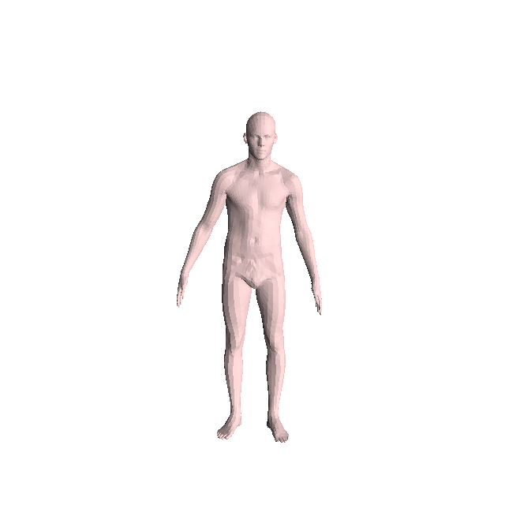
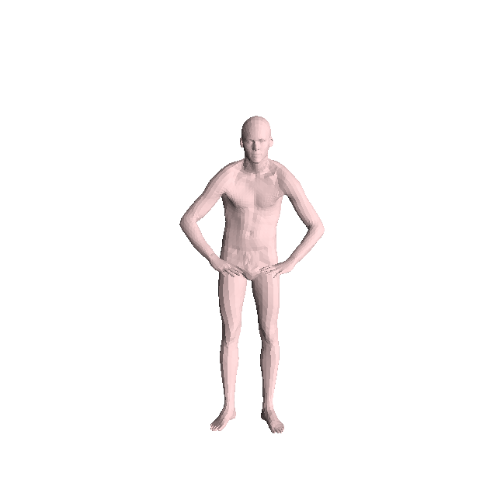
Feature Representation
Assume that having $M\left(M≥2\right)$ models, with $n$ vertices that are in one-to-one correspondence.
Base mesh
Deformed mesh

Slide 4
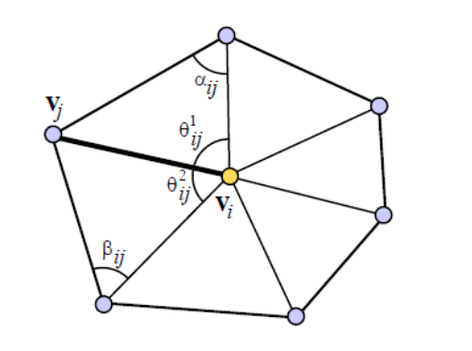
Feature Representation(cont’d)
For each vertex $v_{i}$, the deformation gradient $T_{i}$ can be obtained by minimizing the energy:
Where
$N_{i} :the one−ring neighbors of vertex v_{i}$
$e_{ij}^{′}=p_{i}^{′}−p_{j}^{′}$
$e_{ij}^{}=p_{i}^{}−p_{j}^{}$
$p_{i} and p_{i}^{′} are the positions of v_{i} on the base and deformed models, respectively.$
$c_{ij}=\cot{α_{ij}}+\cot{β_{ij}}$
Notes:
Why we need the cotangent weights?

Slide 5
Feature Representation(cont’d)
After the optimization, the deformation gradient can be decomposed into a rotation part and a scaling/shear part:
$T_{i}=R_{i}S_{i}$
$dR_{ij}=R_{i}^{T}R_{j}$
The RIMD representation is obtained like this:
$f=\left\{logdR_{ij};S_{i}\right\} (∀i,j∈N_{i})$
$$v_{j}$$
$$v_{j}^{′}$$
$$v_{i}$$
$$v_{i}^{′}$$
Notes:
The use of matrix logarithm helps make the feature linearly combinable.

Slide 6
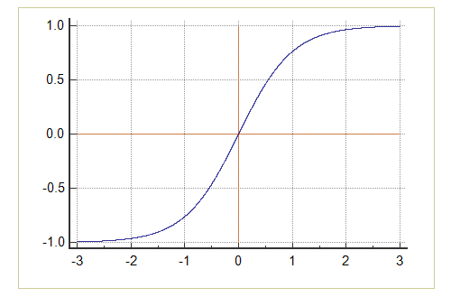
Mesh VAE Feature Preprocessing
The paper propose to use $tanh$ as the activation function of the probabilistic decoder’s output layer but it has the gradient vanishing problem. To avoid this problem, they use uniform normalization to preprocess the feature.
If
Replace them with
In this paper, $ε={10}^{−6}$ and $a=0.9$
tanh

Slide 7
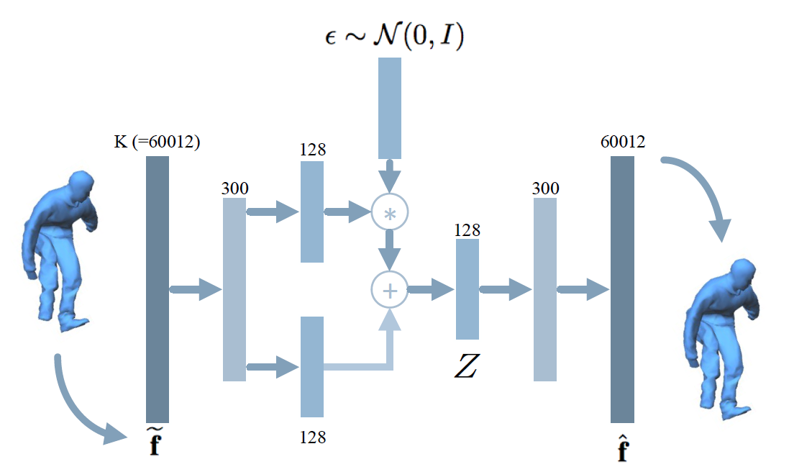
Mesh VAE Mesh VAE Architecture
Suppose a model has 2502 vertices and 7500 edges.
The total dimension K$=2502×6+7500×3×2=60012$

Slide 8
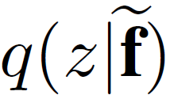
Mesh VAE Mesh VAE Architecture(cont’d)
Loss function is defined as :
where
$M$ is the number of models in the dataset.
$α$ is parameters to tune the priority over the reconstruction loss and latent loss.
$p(z)$ is the prior probability.
is the posterior probability.
Notes:
Prior 與 posterior 的關係

Slide 9
Mesh VAE Conditional Mesh VAE
When synthesizing new shapes, it is often desirable to control the types of shapes to be generated. To achieve this, the loss function can be changed to:

Slide 10
Mesh VAE Extended Model with Improved Low-Dimensional Embedding
This paper modifies the prior distribution of the latent variables to:
$p\left(z\right)=N(z;0,diag(σ_{{object}_{}}^{2}))$
Where $σ_{object}$ is a tunable vector representing the deviation of the latent space.
Notes:
The latent space z provides an embedding that facilitates
various applications. However, to ensure reconstruction
quality, the dimension of z is typically high (over
100), thus not suitable for low-dimensional embedding.

Slide 11
Mesh VAE Applications
Generation and Interpolation
Embedding for Visualization and Exploration

Slide 12
Framework Evaluation Latent Dimensions
Using 128 dimensions is effective in improving reconstruction quality.
Notes:
維度降的太低，會有資訊遺失的問題。
維度降的不夠低，無法改善結果且會有overfitting的問題

Slide 13
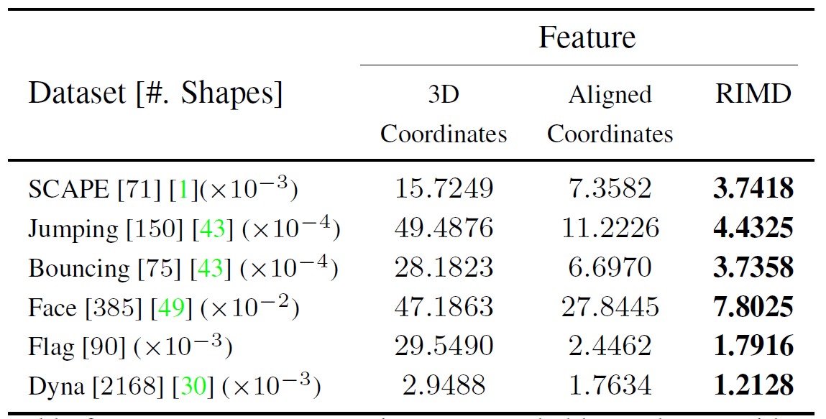
Framework Evaluation RIMD Feature
By finding global rotations that minimize vertex difference
(per-vertex reconstruction errors)

Slide 14
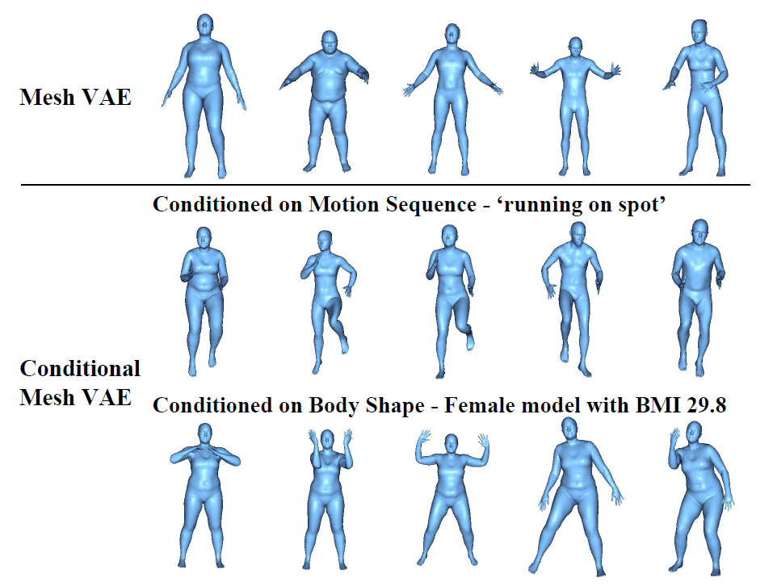
Generation of Novel Models(Conditional Mesh VAE)

Slide 15
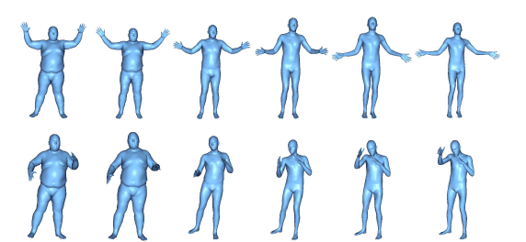
Mesh Interpolation
(Inter-class interpolation with different body shapes and poses)

Slide 16
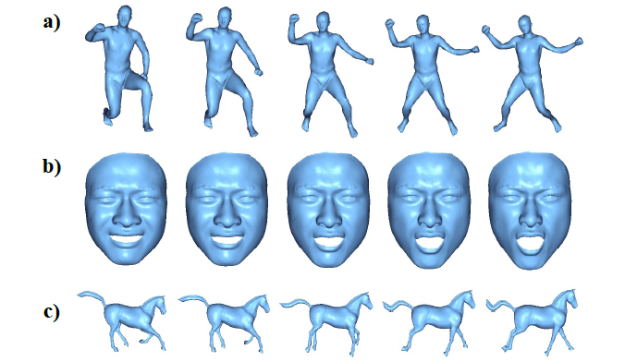
Mesh Interpolation(cont’d)

Slide 17
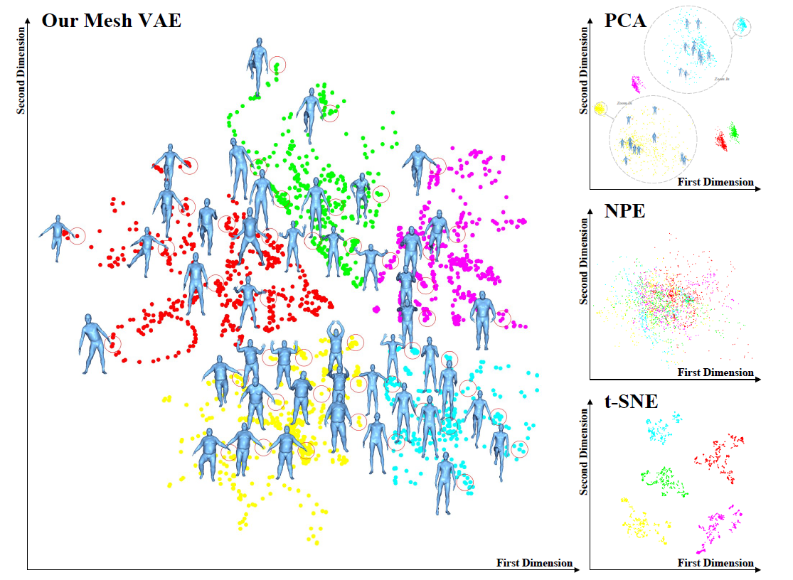
Embedding

Slide 18
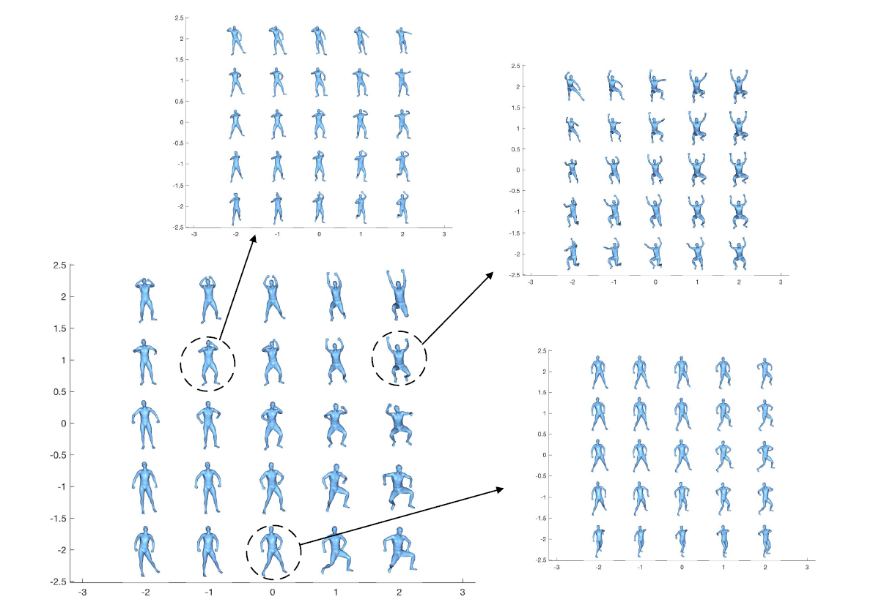
Synthesis based Exploration of the Shape Space
Notes:
透過調整sigma_object的值，觀察mesh的變化

Slide 19
Future work
It is desirable to develop a framework capable of handling shapes with different topologies as input.

Slide 20
Thank you for your listening!

